Slide 2
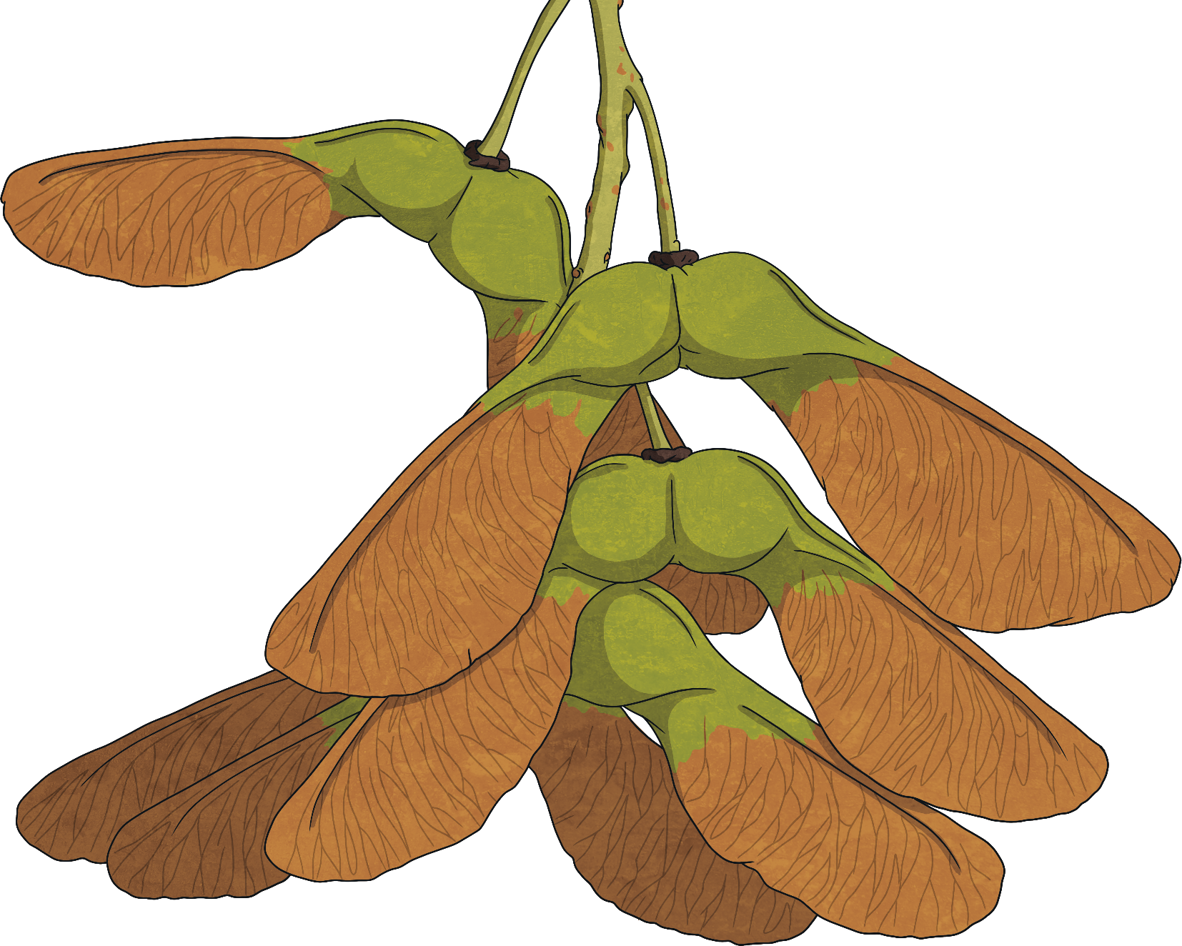
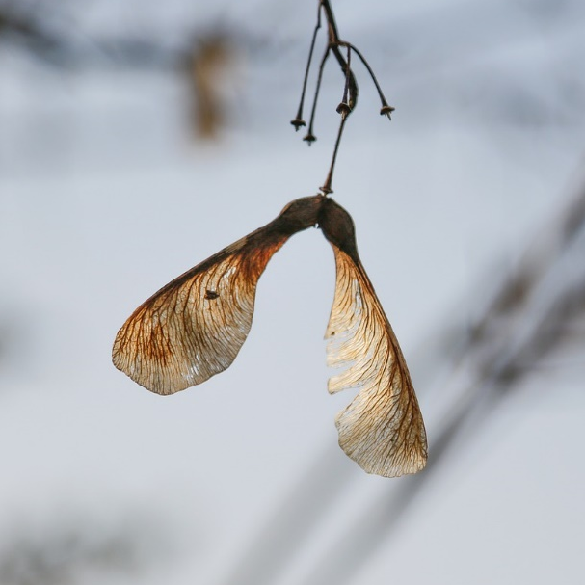
Wind
Sycamore ‘helicopters’ and dandelion ‘clocks’ both have fruits which have adapted to use the wind to carry the seeds away when the seeds are ready.

Slide 3
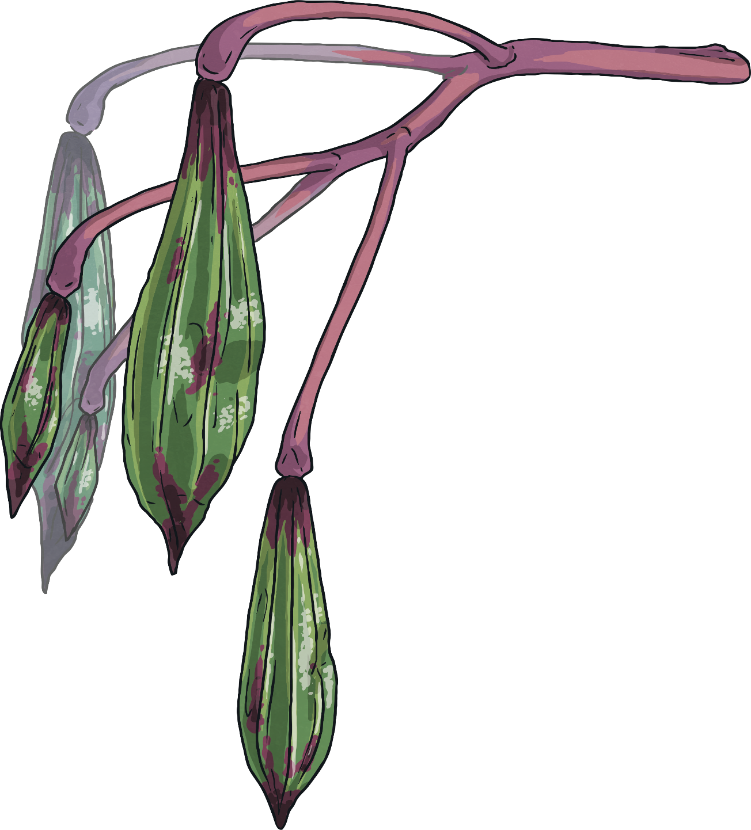
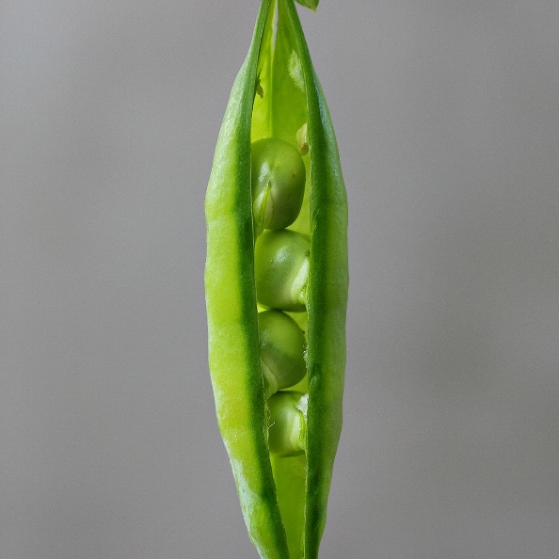
Bursting
Some plants have pods full of seeds which will burst, showering the ground with seeds, like the Himalayan Balsam seed.
Peas are another example of a plant bursting open to disperse its seeds.

Slide 4
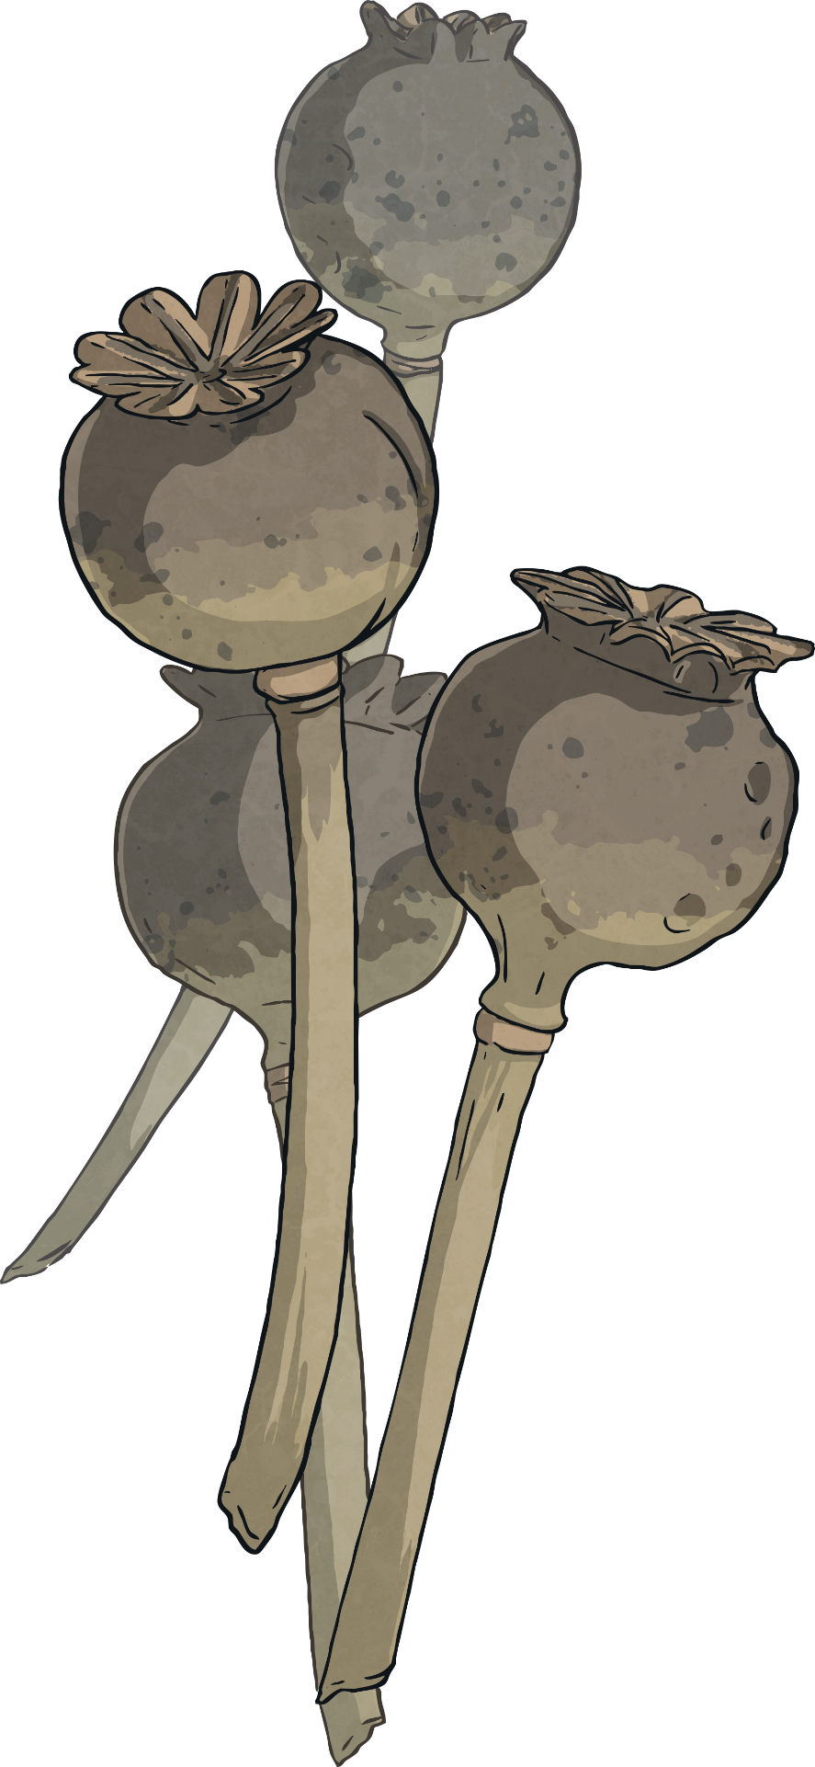
Shakers
Poppy seeds
Some plants rely on being shaken to disperse their seeds. When poppies have produced their seeds and have finished flowering all that is left is a long stem with a dried seed pod.
These pods have small holes at the top and rely on wind to shake them to scatter the seeds. This method doesn’t send the seeds very far. Yucca Campestris seeds also need to be shaken.

Slide 5
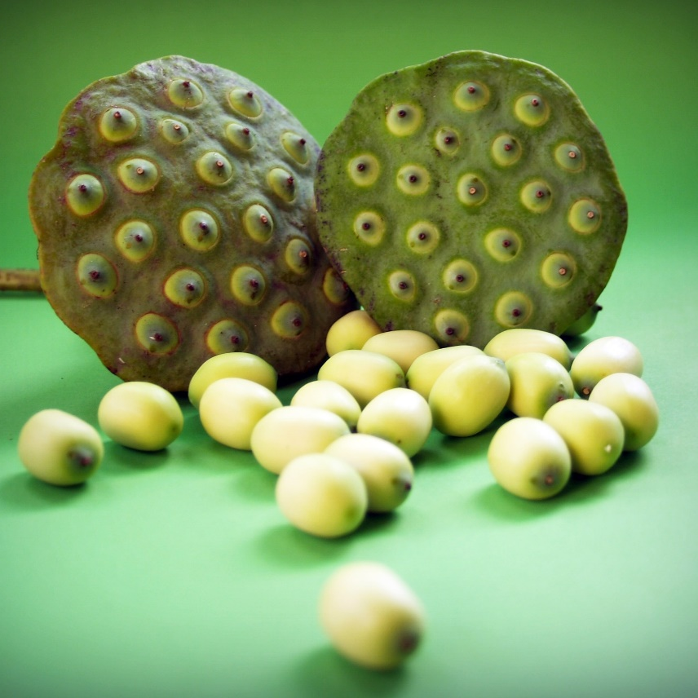
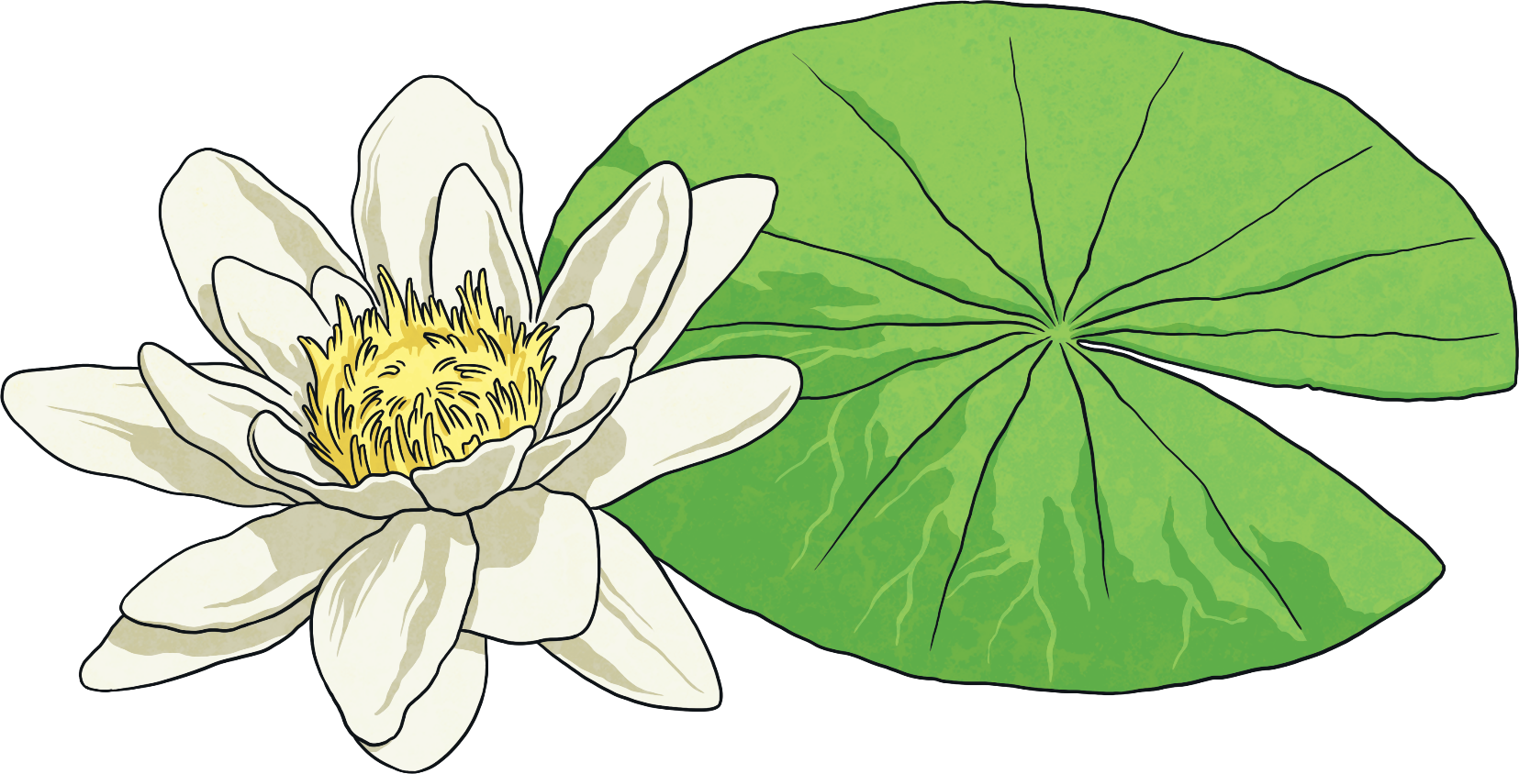
Water
Some plants rely on water to disperse their fruits. These will either grow on the water or by the side of water.
Water lilies live on the water so they use the water to disperse their seeds. They make very light seeds which will float away on the water for a while, then sink to the bottom of a pond to grow a new lily.

Slide 6
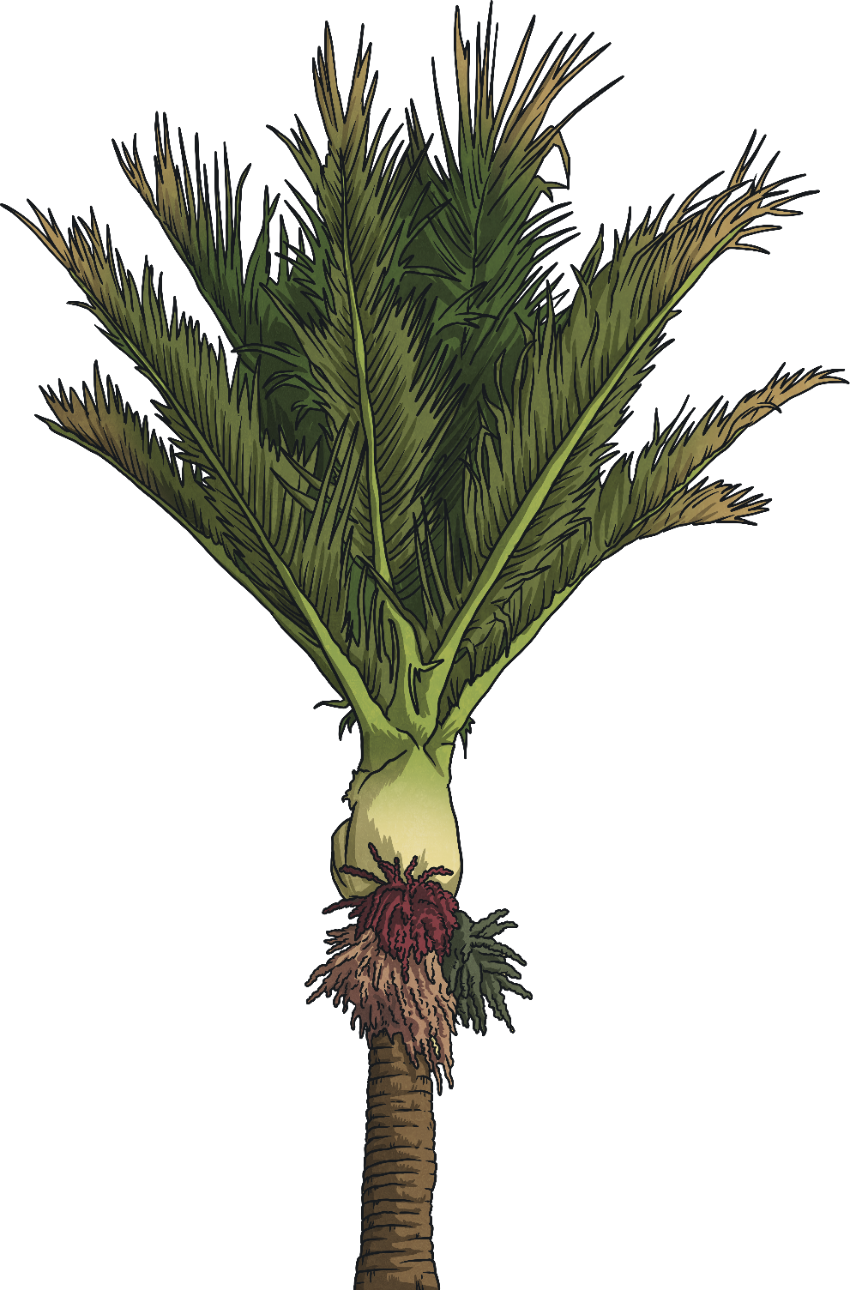
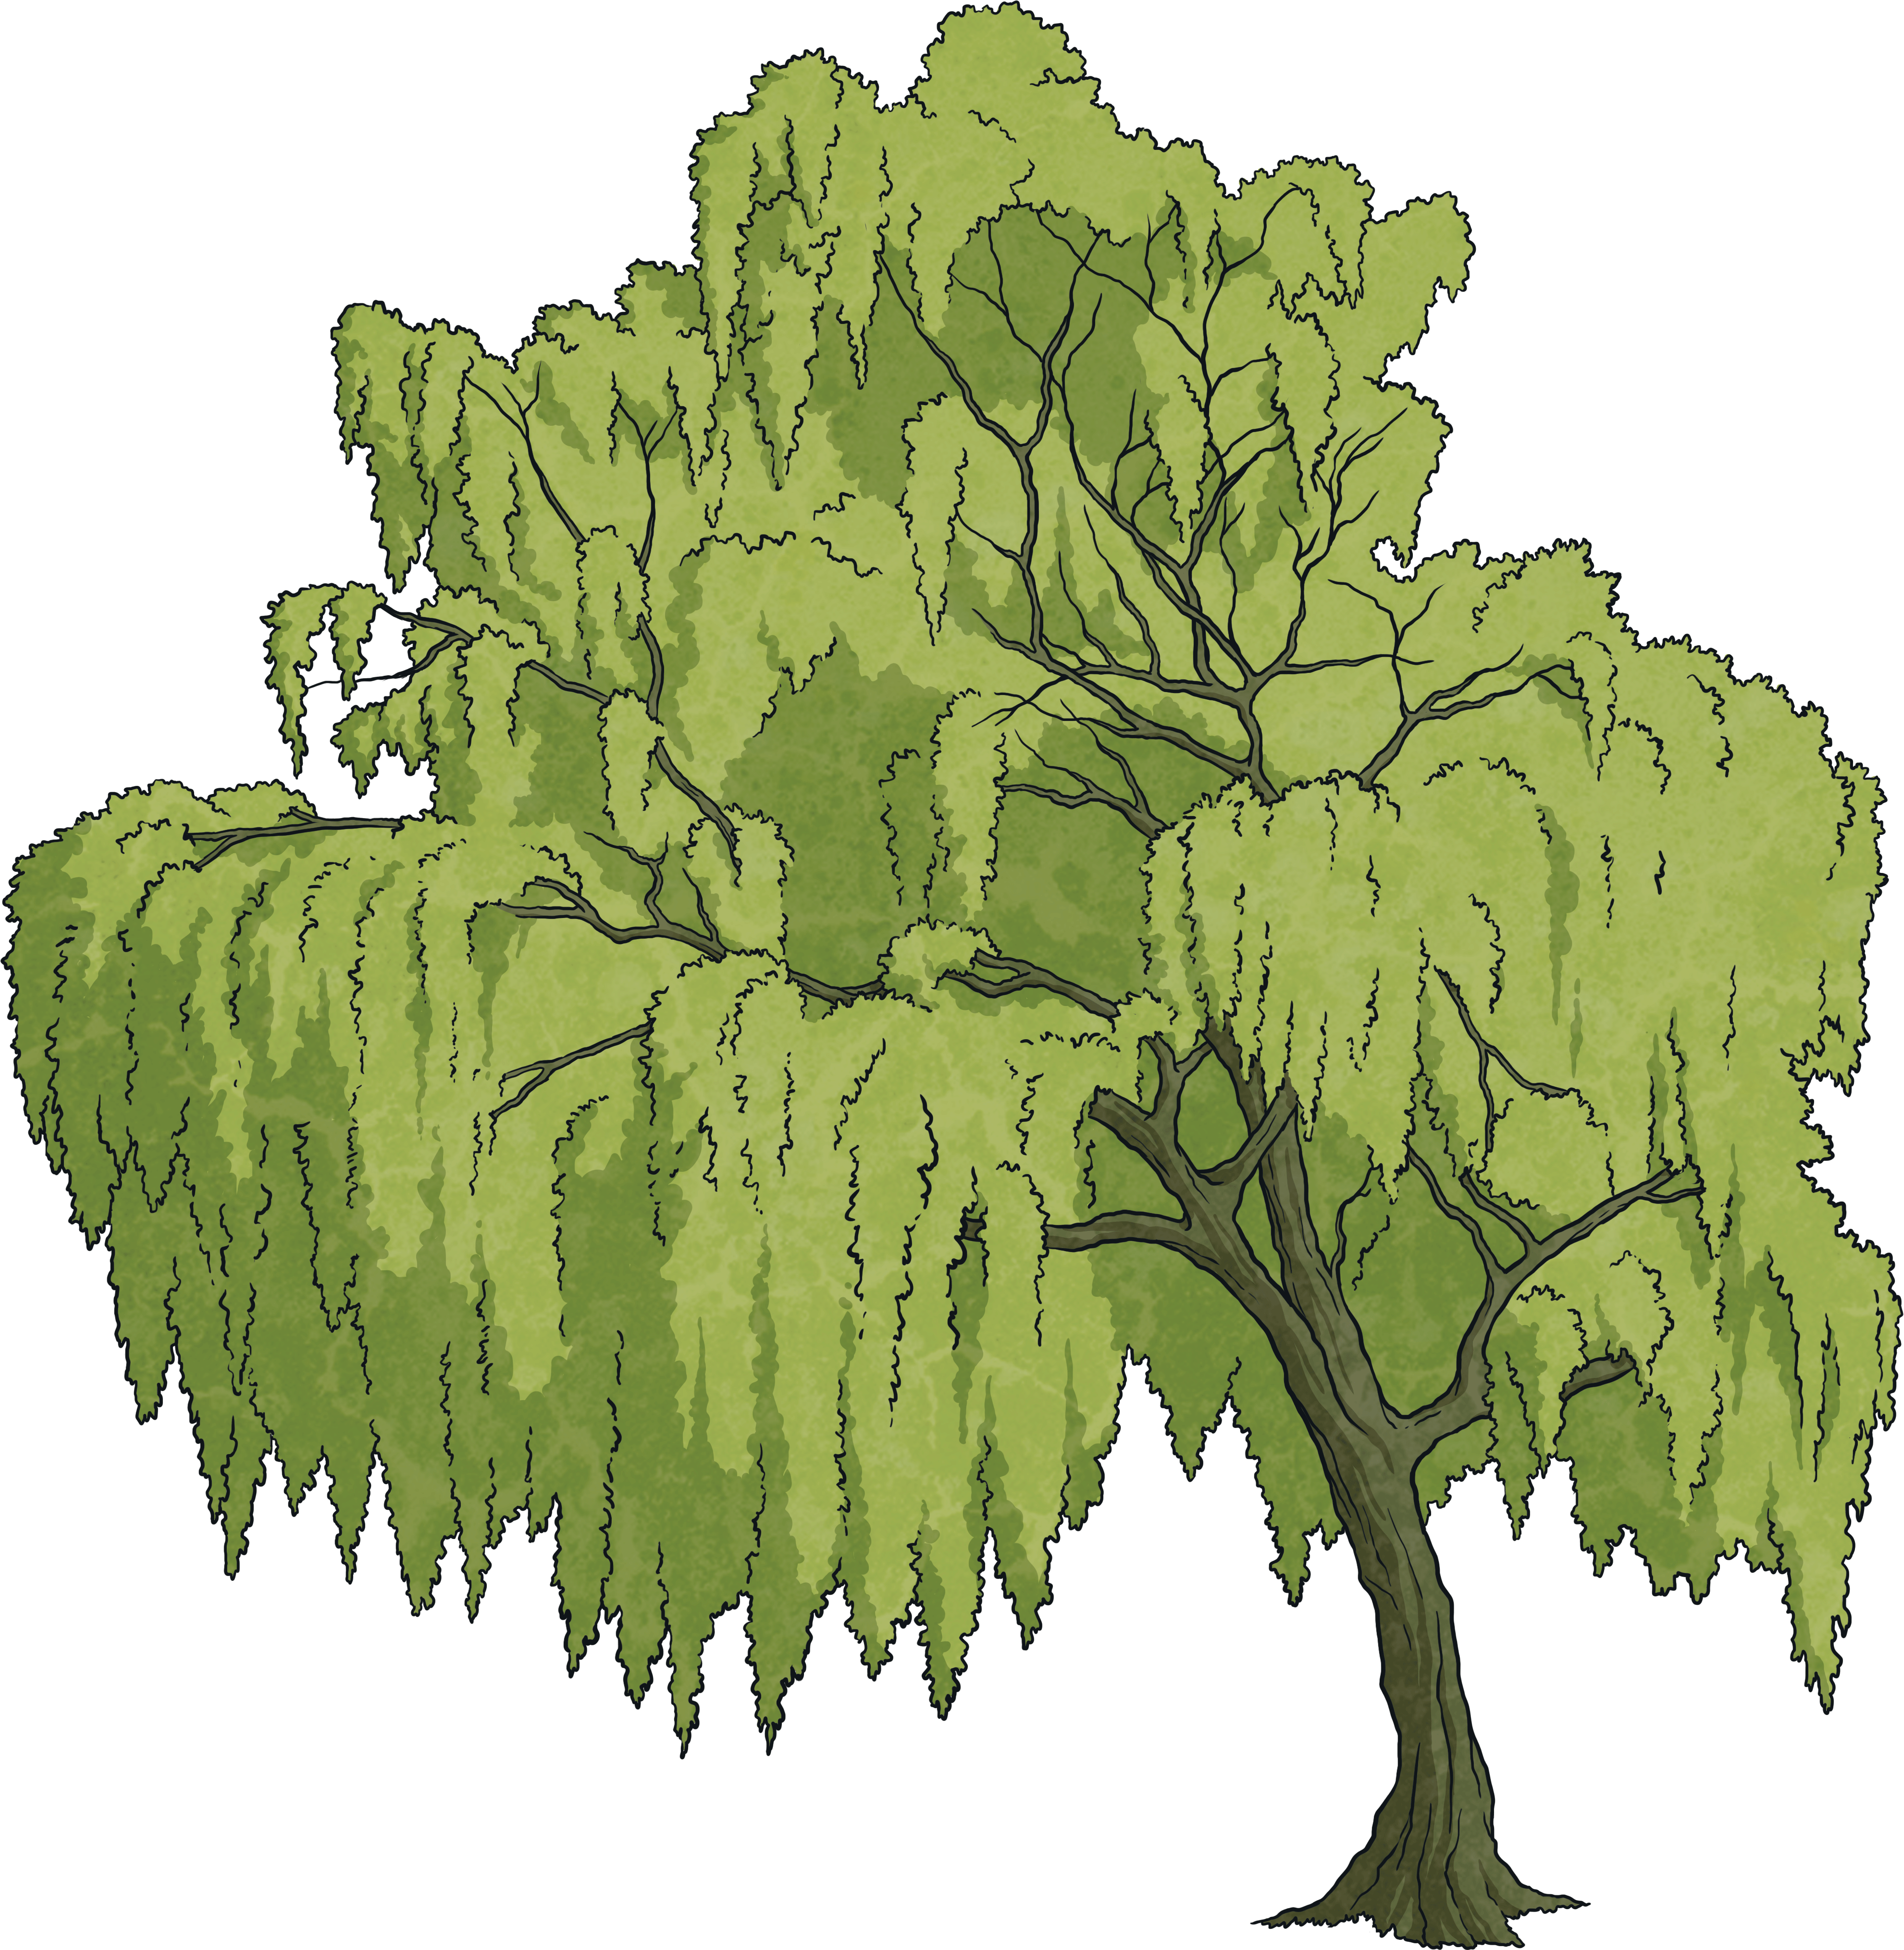
Palm tree seeds are very light which helps them float and grow another palm tree elsewhere. Palm trees that grow by the oceans drop their seeds which can be swept great distances by the ocean’s currents. Coconuts are well known travellers.
Willow and silver birch trees often grow near water. Their seeds are very light which enables them to float away on water (the silver birch seed is also fluffy which helps them to be dispersed by the wind too).

Slide 7
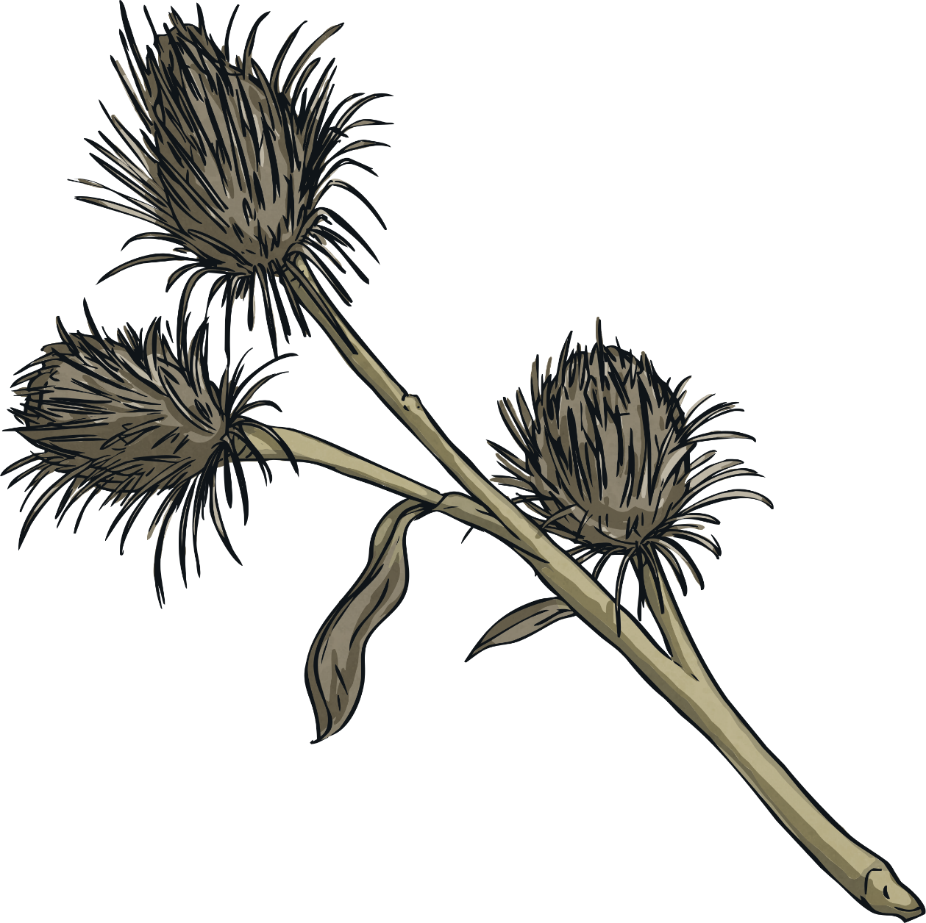
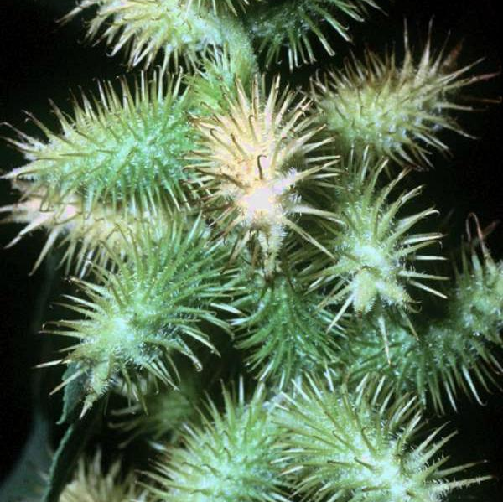
Catching a Ride
Some plants such as cockleburs have developed to grow tiny hooks on their fruits which hook on to animals (or people) that pass by the plant. Eventually they will drop off on to the ground.

Slide 8
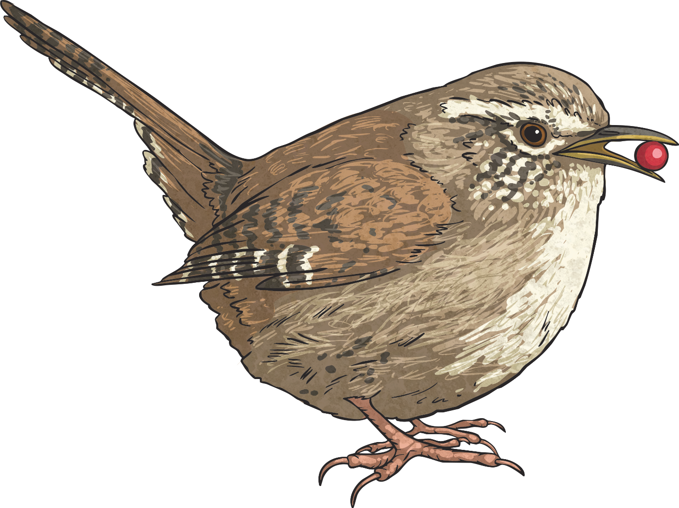
Seeds as Food
Some plants make tasty fruits. This is to encourage animals (and people!) to eat the fruits. The seeds then pass through the animal unharmed and out the other end with a ready supply of fertiliser (not tasty in the slightest… quite the opposite). This method ensures the seed is given nutrients to help it grow.
What types of fruits can you think of that are eaten by animals and people with seeds inside?

Slide 9
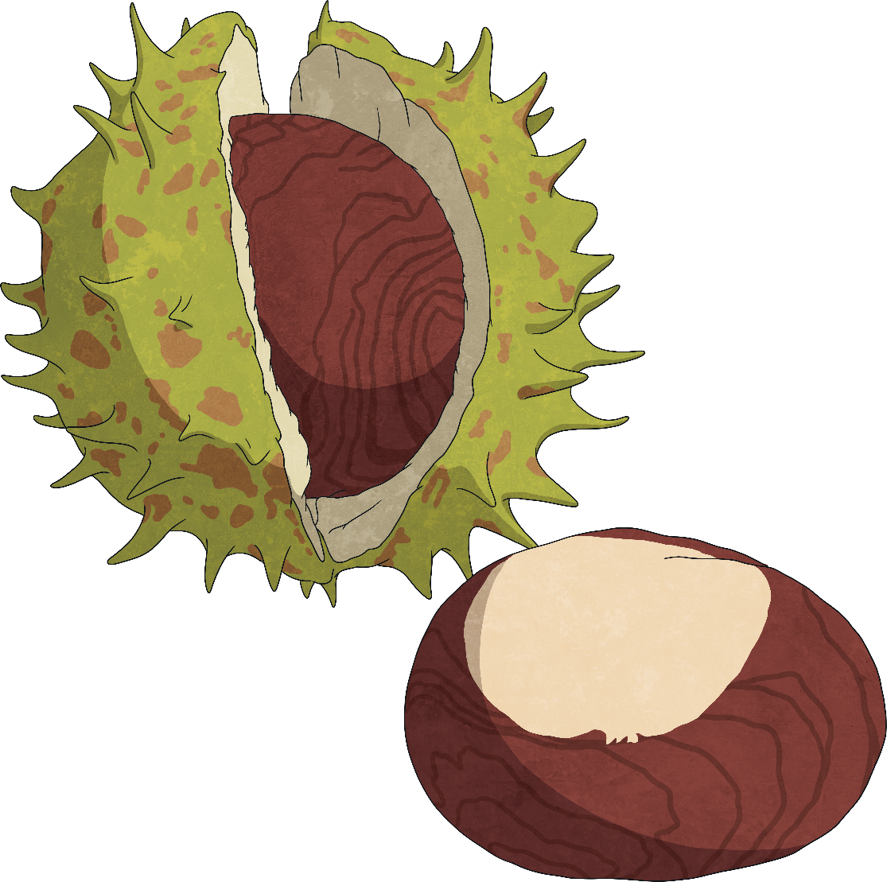
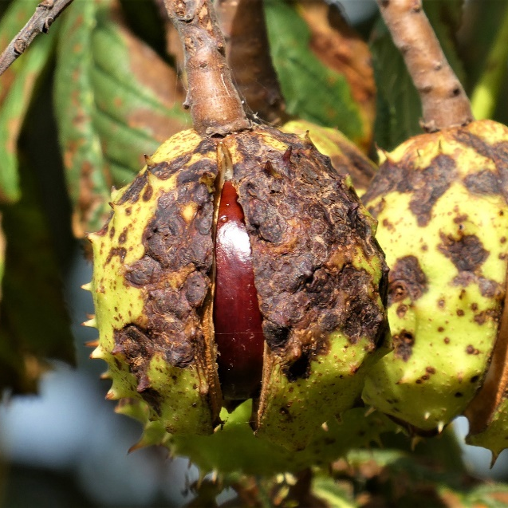
Drop and Roll!
Some fruits, such as horse chestnuts, have a casing round them which cracks open when it hits the ground. The fruit inside then rolls away from the tree.
You can tell which horse chestnuts in the trees are ripe because their casings have already begun to split open before they drop.

Slide 10
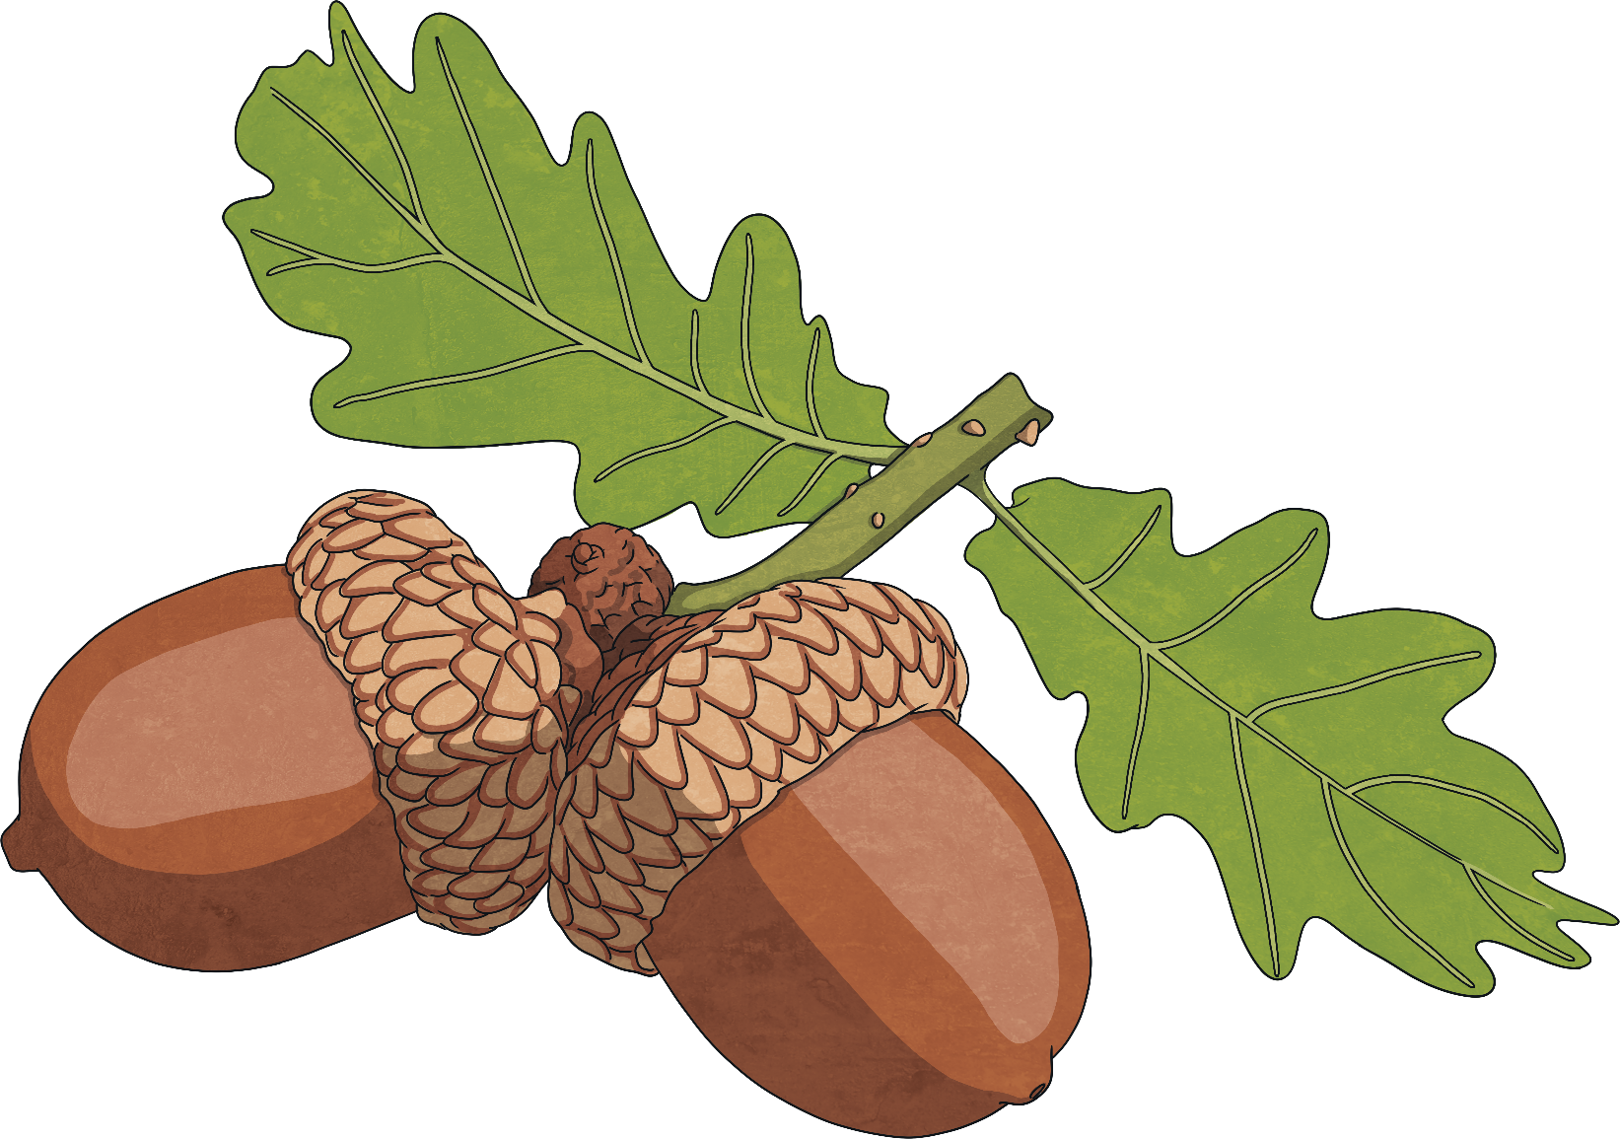
Plenary
Why do plants disperse their seeds?
List the ways in which the seeds are dispersed.

